Slide 1
Stage Gate Evaluation
Autumn Johnson, Lauryn Norris, Mary Pate, Adele Spencer, Mia Henry, Chris Robinson
Notes:
Adele

Slide 2
Goal
Create a sunscreen with:
Maximum SPF and LD50 value
Concerning levels of Oxy Cinnamate and Oxybenzone
Minimum final cost per unit
Find minimum costs of ingredients (sunscreen)
Costs of materials (packaging)
A durable and cheap package that withstands the 8 tests
Notes:
Autumn
Goal: Currently, our task is to create a sunscreen package that withstands the 7 tests (these will be mentioned later) containing the safest and effective formulated sunscreen (created by yours truly), both at the lowest cost possible.
Max LD50
An LD50 is a standard measurement of harmful effects that prevent success and development of a substance that result from either a single exposure or multiple exposures in a short period of time. This measurement is measured in milligrams (mg) of chemical per kilogram (kg) of body weight.
It is important that we have multiple LD50 tests, so we can make sure we are able to use the maximum amount of our active ingredients, in order to provide the best protective sunscreen without harming anyone.
Max SPF
SPF measures sunscreen protection from UVB rays, the kind that cause sunburn and contribute to skin cancer
Min Cost (packing and sunscreen)
Goal: (as mentioned earlier) create sunscreen and package with the least cost

Slide 3
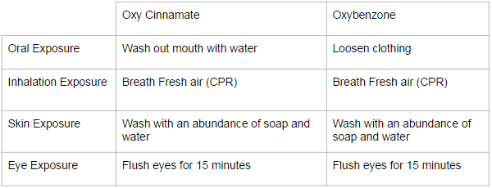
Overview of SDS Information
SDS → Safety Data Sheet
Oxy Cinnamate: http://www.elan-chemical.com/dev/msdspdf/ETHYL%20CINNAMATE.pdf
Oxybenzone: http://www.sciencelab.com/msds.php?msdsId=9926361
Notes:
Mary
Document containing important information on hazardous chemicals and the health and safety of them in an area.
Identify
Health and hazards
Manage safely
Emergency situations
Dispose

Slide 4
Analysis of Sunscreen Materials
Substance | Amount of grams used
Cetyl Alcohol | 2.0 grams
Benzophenone | tbd*
Ethylhexylmethoxycinnamate | tbd*
Steric Acid | 4.0 grams
Glycerin | 2.0 grams
Trethanol Amine | 1.0 grams
Water, Distilled | 78.0 grams
Source
alibaba
makingcosmetics
Makingcosmetics
chemistryconnection
bolkapothecary
bonanza
coxhardwire
Cost per gram
$0.0012
$0.053
$0.053
$0.005
$0.0031
$0.04
$0.0004
Total cost
$0.0024
$tbd*
$tbd*
$0.02
$0.0062
$0.04
$0.0312
tbd* - to be determined based off of LD50
Total Unit Cost for Chemicals: $0.0998 + tbd* costs
Notes:
Autumn

Slide 5
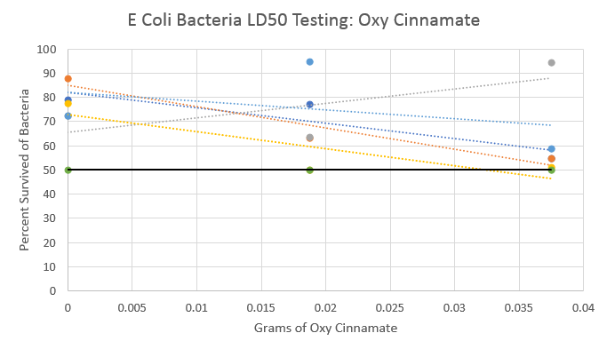
LD50 data: Oxy Cinnamate (E Coli)
Notes:
Mary

Slide 6
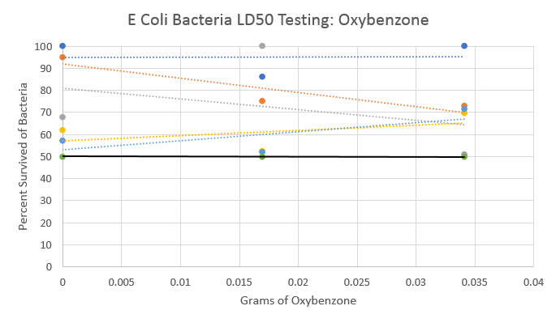
LD50 data: Oxybenzone (E Coli)
Notes:
Mary

Slide 7
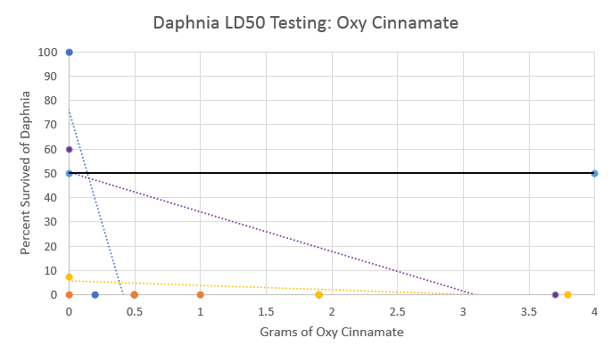
LD50 data: Oxy Cinnamate (Daphnia)
Notes:
Mary

Slide 8
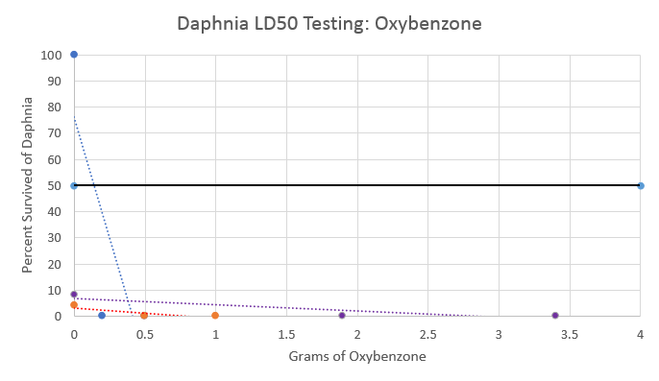
LD50 data: Oxybenzone (Daphnia)
Notes:
Mary

Slide 9
LD50 data: Oxybenzone and Oxy Cinnamate (Human)
Trial | Oxybenzone | Oxy Cinnamate | Results
Legal Amounts | 5.28 grams | 6.6 grams | Did not test this amount
Trial #1 (50%) | 2.64 grams | 3.3 grams | No irritation
Trial #2 (75%) | 3.96 grams | 4.95 grams | No irritation, skin became red
Trial #3 (66.66%) | 3.52 grams | 4.4 grams

Slide 10
Conclusions From LD50
Never reached LD50 → Decrease amount of chemicals and continue testing
Notes:
Mary

Slide 11
Material Testing Data
Material | Drop | Shake | Weight | Throw | Water | Heat | Overall Average
Newspaper
Cardboard
Plastic Bag
Plastic Wrap
Foil
Wax Paper
Duct Tape
Masking Tape
3 | 3 | 2 | 3 | 1.5 | 3 | 2.58
3 | 3 | 1.5 | 2.5 | 1.75 | 3 | 2.46
3 | 3 | 3 | 3 | 3 | 3 | 3
2 | 2.5 | 2 | 2 | 3 | 3 | 2.42
2.5 | 2 | 2 | 2 | 3 | 3 | 2.42
3 | 2.5 | 2 | 2 | 3 | 3 | 2.58
3 | 3 | 3 | 3 | 2.5 | 3 | 2.92
2.5 | 3 | 2 | 2.5 | 1.5 | 2 | 2.25
Notes:
Lauryn
Averages - done
Scale: 0 is worst and 3 is best

Slide 12
Package #1
Notes:
Lauryn

Slide 13
Package #2
Notes:
Adele
Justifications
Cardboard
Plastics bags
Wax Paper
Hot Glue

Slide 14
Package #2 Testing Data
Trial | Drop | Shake | Weight | Throw | Water | Heat
1 | 3 | 3 | 3 | 3 | 3 | 3
2 | 3 | 3 | 3 | 3 | 2.7 | N/A*
3 | 2.8 | 3 | 2.7 | 3 | 2.5 | N/A*
Average | 2.9 | 3 | 2.9 | 3 | 2.73 | N/A*
N/A* - Not available because for heat test only 1 trial was necessary
Notes:
Lauryn

Slide 15
Modifications
Add more wax paper around the cylinder and apply more glue to make it more water resistant
More glue around the base

Slide 16
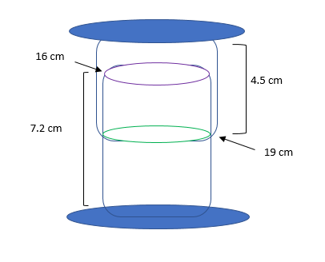
Creation Process and Dimensions of Package #3
Two cylinders that fit snugly together from cardboard
Coated inside of cylinders with plastic baggie and outside of cylinders with wax paper
Two supporting circles (top & base)
Coated inside of circles with plastic baggie and outside with wax paper
Insulated any cracks or openings with hot glue
Notes:
Adele

Slide 17
Cost of Package #3
Materials | Cost per specific material | Amount of specific material
Cardboard Square | $1.00 | 1 square
Plastic Baggie | $0.25 | 1 bag
Wax Paper (30 x 15 cm) | $0.50 | 1 piece
Total Package Cost: $1.75
Maximum cost with hot glue = $3 - No restriction on hot glue*
Notes:
Adele

Slide 18
Total Cost of Model #3
Material | Cost
Chemicals | $0.10 (plus TBD)
Package | $1.75
Total Unit Cost: $1.85 (Plus TBD)
Notes:
Adele

Slide 19
Conclusion
Progress
Decreased our price drastically
Discovered we need to use much less Oxy Cinnamate and Oxybenzone
Improved or model in water resistance and durability
The Future
Test our new model
More clean cut gluing/application of plastic and wax paper
Test Daphnia with much less Oxy Cinnamate and Oxybenzone

Slide 20
Thank You Questions?
Notes:
Adele

